Slide 1
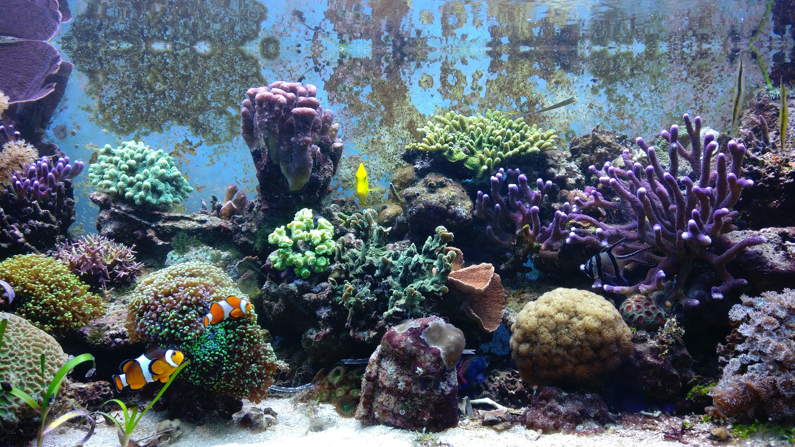

Slide 2

R for Reproducible data wrangling
GenGen workshop???
15.02.2023
Giulia Puntin
@sPuntinGi
What happens before the stats:
the power of R Tidyverse for
wrangling, cleaning, and exploring your data.
Add nice ggplots and drawings from anne horst about tidyverse

Slide 3
Slide presentation points:
Very brief intro to the concept of reproducible research and the importance of working in scripts (as opposed to manual edits of spreadsheets)
Advantages of using R from the very beginning and at each step in which any sort of data manipulation is required (not just for the final stats)
Why R when one can do most of this in bash/Unix?
“safer” approach: R doesn’t modify data files directly, more wiggle room for trial and error (although disadvantages/additional steps when you want to directly access and modify your data – see it as a complementary tool)
Convenience to have “all in one place”: seamlessly proceed with data visualization (ggplot!) and statistical testing
Deal with biologists: (unlike bioinformaticians) most biologists usually only know R …
Intro to the Tidyverse: a collection of packages in R that share a common “philosophy” (fit well together) and rely on the concept of “tidy” data
Explain tidy data structure (and what is not), and “long” and “wide” data format (link to original paper)
Brief definition of data wrangling: subset, summarize, merge tables, pivot …
Brief overview of most useful tidyverse functions and approaches to the (mentioned above) most common needs:
Create new variables: mutate()
Summarize and check data structure): group_by() + summarize()
Subset: filter(), select()
Merge: inner_join(), left_join(), outer_join() …
Restructure: pivot_wider(), pivot_longer()
Change/correct values: rename(), replace()
Visualize data (plot): ggplot()
Text manipulation (regex): {stringr} stringr::str_subset(), str_replace(), separate(), …
Quick intro to the dummy data set (made up by me with features to exemplify the above functions)

Slide 4
R is for “Reproducible”
Very brief intro to the concept of reproducible research and the importance of working in scripts (as opposed to manual edits of spreadsheets)

Slide 5
R from the start
Advantages of using R from the very beginning and at each step in which any sort of data manipulation is required (not just for the final stats)

Slide 6
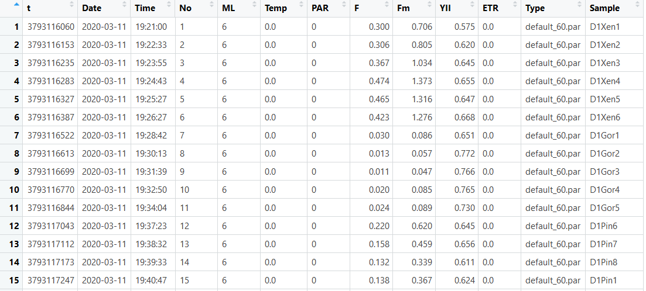
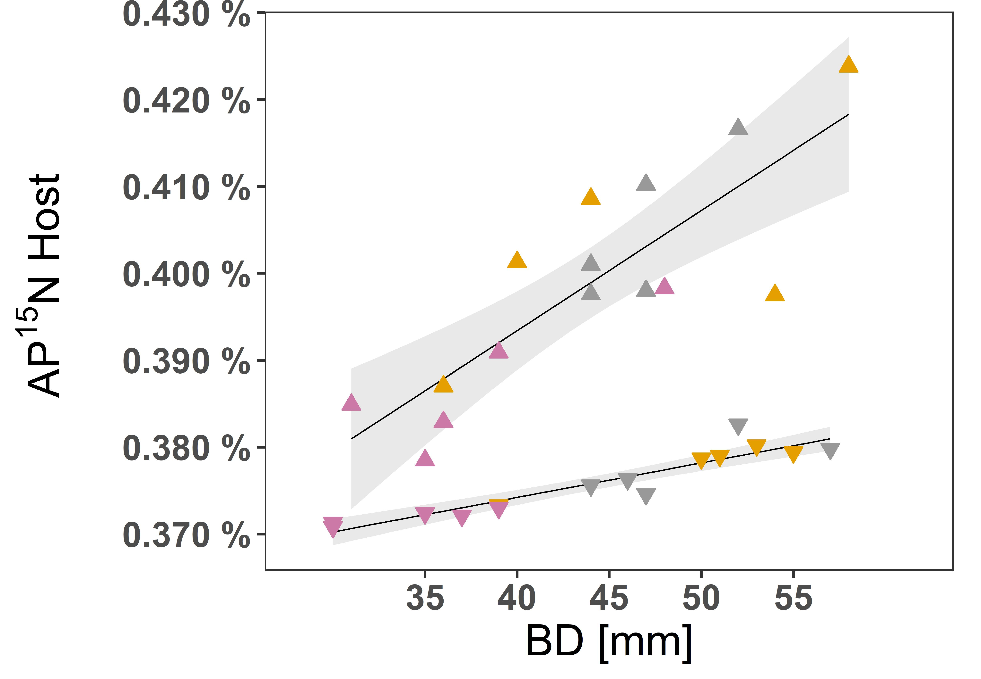

Reproducibility
Analyze the same data and obtain the same results
Data
Published results
Data analysis
script
Notes:
So let’s start by briefly defining it: simply put this can be summarized in the idea that by analysing the same data one should obtain the same results. Practically speaking, this means sharing the data as well as the details of how the data was analyzed.

Slide 7
Reproducible research
Analyze the same data and obtain the same results
In the paper
Data
Published results
Data analysis
script
In the supplementary material
(ideally … )
Notes:
Typically in a paper (scientific article) you have a general description of the statistical analysis (tests used, parameters etc) and the relevant results. Then in the SM you should have the actual data and scripts to perform the analysis (can be in R, but can also be other languages). (Ideally … coz in reality doesn’t always happen … but yeah, we aim to be that kind of shary scientists !).

Slide 8
Reproducible research
Cleaned data
ready for stats
But there’s also that other part …
Data
Published results
Data analysis
script
Notes:
BUT, there is also another aspect to consider: the data that is ready to be analyses (do the stats) … was very likely not “born” in that way

Slide 9
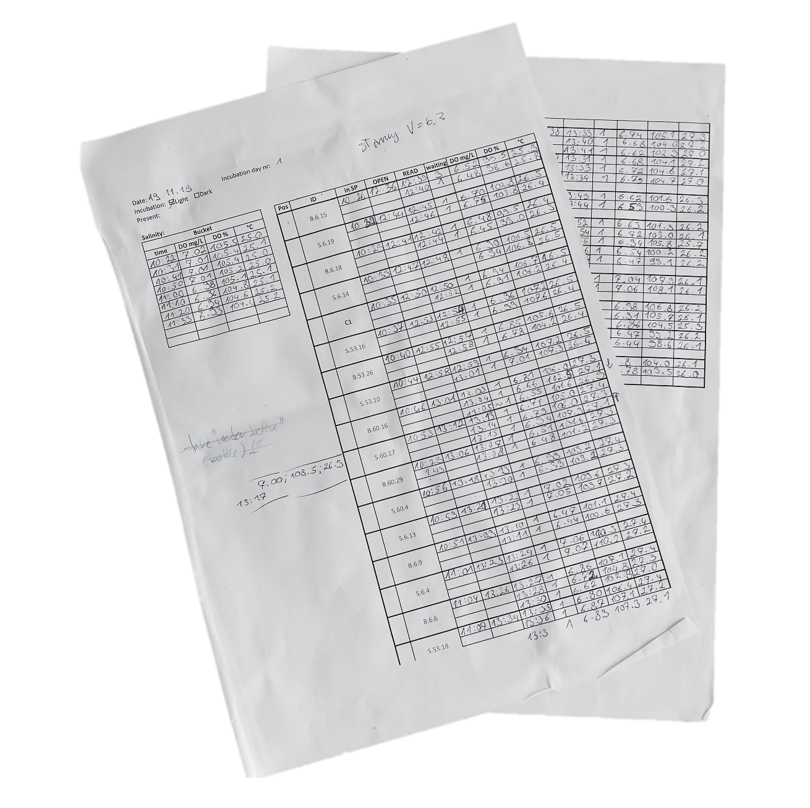
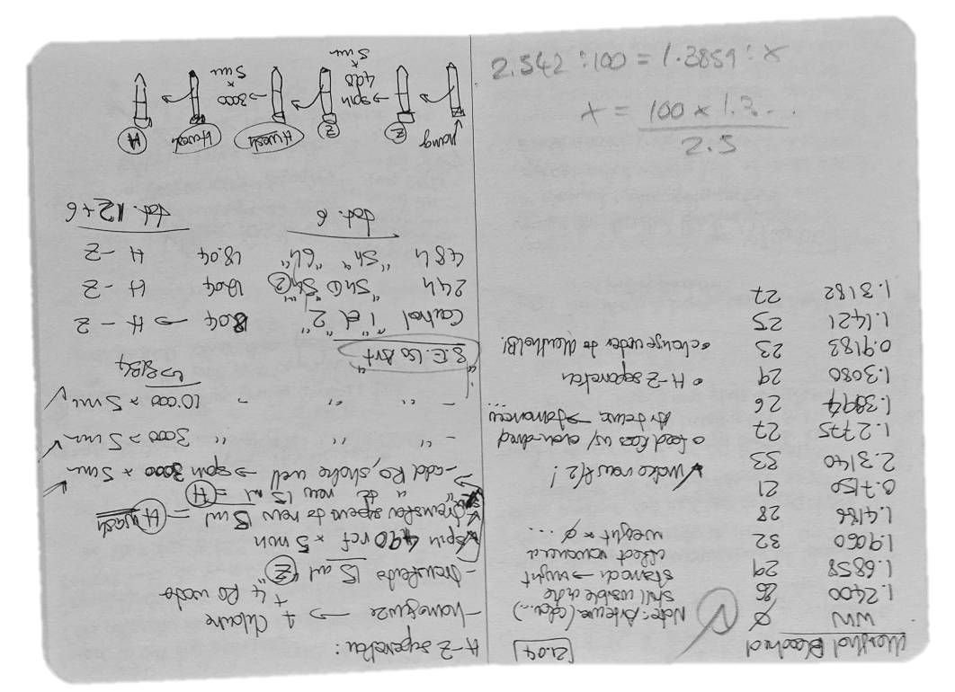
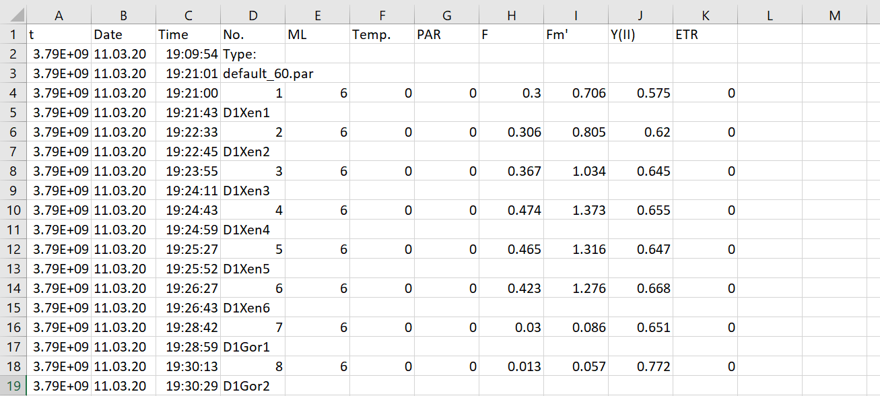

Reproducible research
Original data
original outputs
Cleaned data
ready for stats
hand notes
Published results
digitalize
Data
wrangling
Data analysis
script
Notes:
In most cases (at least in my experience), this is a more realistic situation! Data comes from different sources and in different shapes.
For example if you’re recording reading from instruments (like, DO oxygen in incubations, or physical measurements like weight and size … ) your data probably comes in some hand-written notes. Data can also come already in a digital format (temperature loggers, PAM … !), but it’s still not ready to be used.
This because you need to check for examples that the samples are named correctly (spelling), or that the tables are in the right shape (e.g. PAM!) and also you probably want to join separate tables into a single one and maybe even add extra information that might be stored in a separate file/table.

Slide 10



Unusable format …
… ready to be analyzed ☺
https://pokingcorals.blog/r-to-reshape-pam-csvs/
Notes:
Practically speaking: example of …

Slide 11
Reproducible research
Original data
original outputs
Cleaned data
ready for stats
hand notes
Published results
digitalize
Data
wrangling
Data analysis
script
Too often overlooked/underestimated:
1. badly done (= NOT reproducible)
2. time consuming (can take up as more time than stat testing)
= sensitive step that can benefit a lot from improvement
Notes:
This is called “data wrangling” and I want to talk about it because this part is surprisingly often overlooked => 1. badly done and 2. can take up as much time as the statistical data analysis (if not more) = sensitive step that can benefit a lot form improvement.
What I mean with overlooked/underestimated is that during students training there is a lot of focus on learning R for stats and making plots, but very rarely (if ever) the part before is given any attention. You’re somehow supposed to figure it out by yourself. Which I don’t think is a very effective approach … because what people do is to use what seems “easier” to do

Slide 12


Reproducible research
Original data
original outputs
Cleaned data
ready for stats
hand notes
Published results
digitalize
Data
wrangling
Data analysis
script
Notes:
So what happens is that most people (especially R beginners – but not only!) use what they are already familiar with: spreadsheets (excel). Which looks user friendly but trust me it is not good for reproducibility!
While are necessary for digitalizing data (manually write into cells …), that’s it.

Slide 13
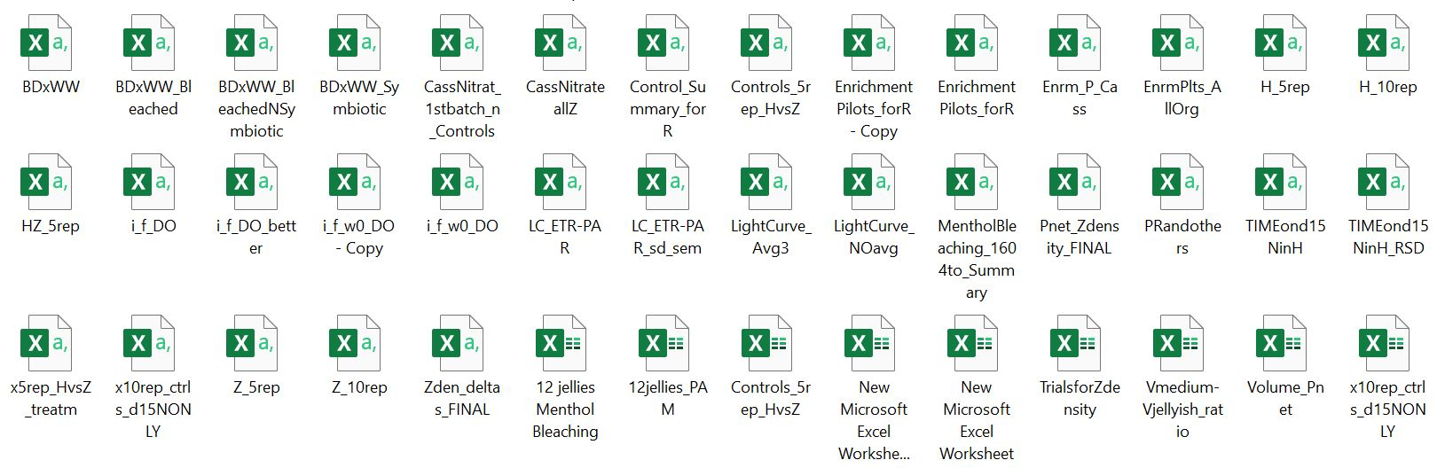
Does this look familiar?
Typical scenario of what happens when working in data in Excel: a new file is created for each version …
Naming can only help so much …
Notes:
And I really speak for experience here (and that’s why I’m so invested in this workshop) because this is a screen shot of my folder of my MSc’s thesis. More than one year later I resumed it to prepare a publication and

Slide 14
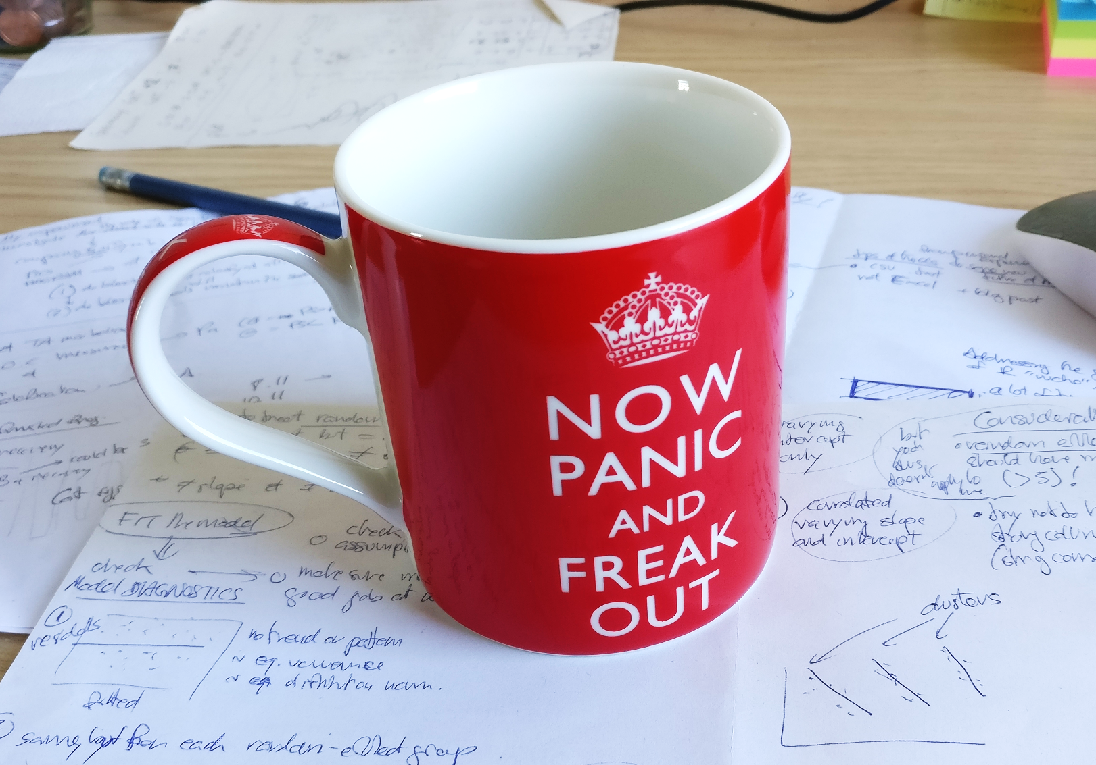
Does this look familiar?
Typical scenario of what happens when working in data in Excel: a new file is created for each version …
Naming can only help so much …
Notes:
Yes, panic and freak out. So I ended up re-doing EVERYTHING, but this time in R and it was sooo much better!

Slide 15
Shortcomings of working with spreadsheets (and why I hate it)
Problems derived from working with spreadsheets:
Messy (many files) …
Error prone (e.g. manually copy-pasting the wrong thing in the wrong place)
Not scalable (it just doesn’t work with large data sets)
Not reproducible (good luck trying to figure out what happened there … !)
On the contrary, by working in R, you can do everything without ever altering the original data!
(which also means that you can change your mind and easily un-do and re-do any operation)
Notes:
Also, data wrangling in spreadsheets comes with other limitations besides the messiness …

Slide 16
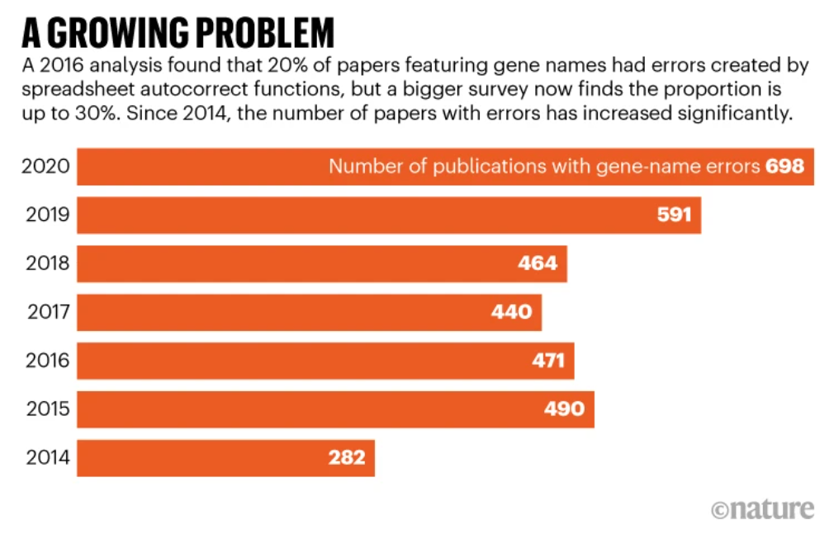
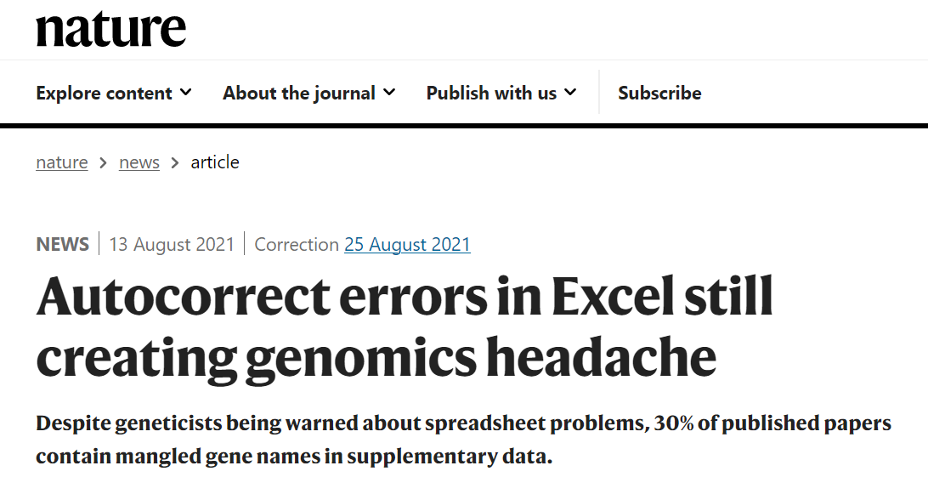
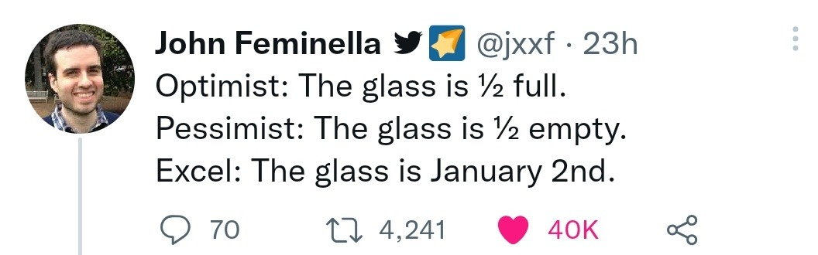
Disclaimer
Excel can also do great stuff if you put the time to learn it (ask Dan for example?)
However, I find it so error prone that I do not even trust myself with it …
Also, larger scale problems:

Slide 17
Original data
original outputs
Cleaned data
ready for stats
hand notes
Published results
Data
wrangling
digitalize
Data analysis
script
Notes:
So, I’m a great fan of pushing for R instead of excel!

Slide 18
Reproducible research
Original data
original outputs
Cleaned data
ready for stats
hand notes
Published results
digitalize
Data
wrangling
Data analysis
script

Slide 19
Why R when one can do most of this in bash/Unix?
Nothing against them, these languages/systems have their good reasons to exists!
However, I recommend also implementing R in your analysis because:
“safer” approach: R doesn’t modify data files directly, more wiggle room for trial and error (although disadvantages/additional steps when you want to directly access and modify your data – see it as a complementary tool)
Convenience to have “all in one place”: seamlessly proceed with data visualization (ggplot!) and statistical testing
Deal with biologists: (unlike bioinformaticians) most biologists usually only know R …
Notes:
But also, you might be wondering … why not XXX ?

Slide 20
Reproducible research
Original data
original outputs
Cleaned data
ready for stats
hand notes
Published results
digitalize
Data
wrangling
Data analysis
script
Reproducible data manipulation:
use R from the very beginning of your work with data
(not just for the stats and plots)!
Notes:
R for data wrangling! Particulalry, TIDYVERSE! (show later differences from base R)

Slide 21

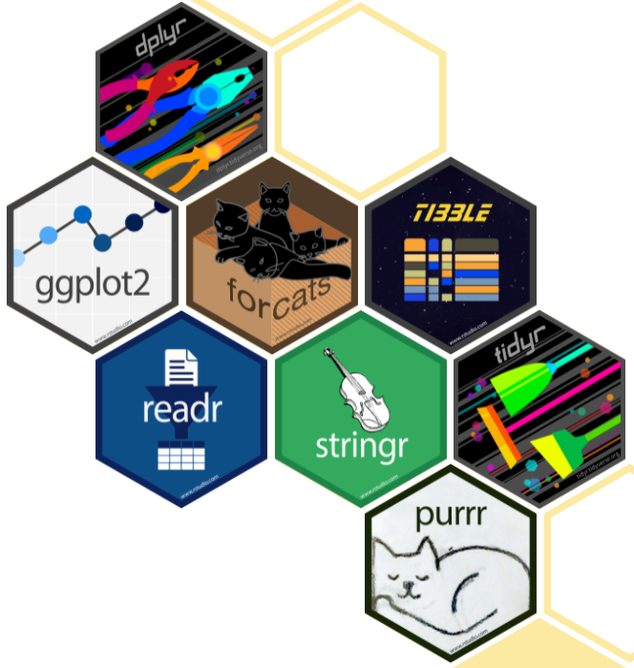
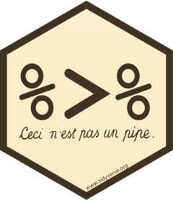
Tidyverse
A collection of R packages designed for data science, that share an underlying design philosophy, grammar, and data structures.
“A gateway drug … “
Noteworthy aspects:
Concept of “Tidy data”
The pipe (%>%) (move away from nested functions)
https://www.tidyverse.org/
Notes:
A collection of packages that do cool stuff (we’ll see soon) (e.g., ggplot2)

Slide 22
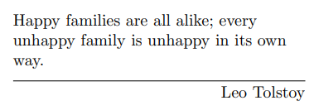
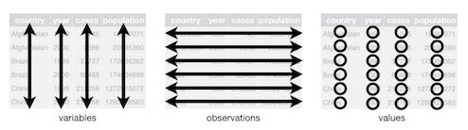
1. Tidy data
Simple rules:
Every column is a variable.
Every row is an observation.
Every cell is a single value.
12 Tidy data | R for Data Science (had.co.nz)
12 Tidy data | R for Data Science (had.co.nz)
Notes:
Seems obvious, right? What would you say about these three tables here, are they examples of tidy data?
Tricky, ah? Take your time to familiarize yourself with the concept, a great read is of course the material produced by Hadley Wickham … LINK
Is this a long or wide?

Slide 23
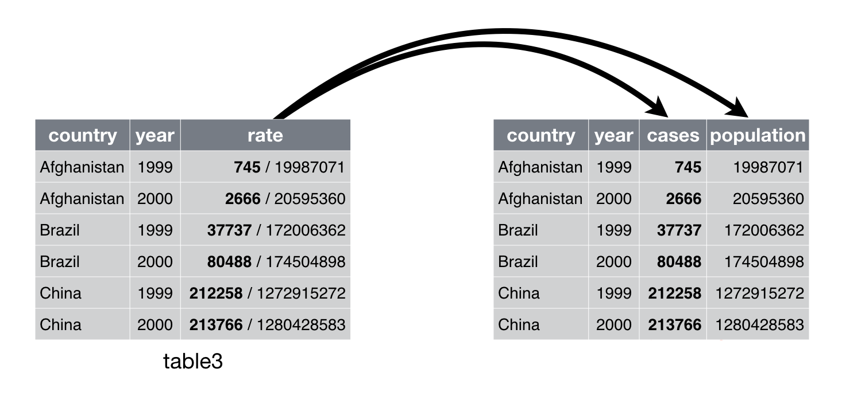
1. Tidy data
Simple rules:
Every column is a variable.
Every row is an observation.
Every cell is a single value.
12 Tidy data | R for Data Science (had.co.nz)
12 Tidy data | R for Data Science (had.co.nz)
Notes:
Seems obvious, right? What would you say about these three tables here, are they examples of tidy data?
Tricky, ah? Take your time to familiarize yourself with the concept, a great read is of course the material produced by Hadley Wickham … LINK
Is this a long or wide?

Slide 24


1. Tidy data
Simple rules:
Every column is a variable.
Every row is an observation.
Every cell is a single value.
12 Tidy data | R for Data Science (had.co.nz)
12 Tidy data | R for Data Science (had.co.nz)
Notes:
Seems obvious, right? Well, you’ll encounter many instances of non-tidy data, some more obvious than others. This one for examples is quite easy to spot as the “/” indicates two separate things ….
What would you say about these three tables here, are they examples of tidy data?
Tricky, ah? Take your time to familiarize yourself with the concept, a great read is of course the material produced by Hadley Wickham … LINK
Is this a long or wide?

Slide 25
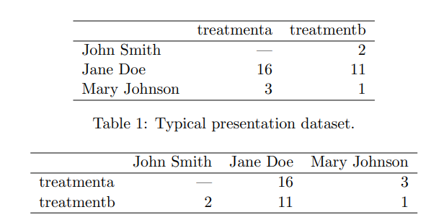
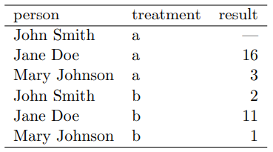
1. Tidy data
Simple rules:
Every column is a variable.
Every row is an observation.
Every cell is a single value.
12 Tidy data | R for Data Science (had.co.nz)
Wickham (2014)
Tidy Data | Journal of Statistical Software
Notes:
But this one might be a bit more tricky …
Tricky, ah? Take your time to familiarize yourself with the concept, a great read is of course the material produced by Hadley Wickham … LINK
Is this a long or wide?
[Every value belongs to a variable and an observation. -> tip: the empty cell between rownames and colnames indicates non-tidy data …]

Slide 26
1. Tidy data
Simple rules:
Every column is a variable.
Every row is an observation.
Every cell is a single value.
12 Tidy data | R for Data Science (had.co.nz)
“wide”
“long”
“wide”
Wickham (2014)
Tidy Data | Journal of Statistical Software
Notes:
But this one might be a bit more tricky …
Tricky, ah? Take your time to familiarize yourself with the concept, a great read is of course the material produced by Hadley Wickham … LINK
Is this a long or wide?
[Every value belongs to a variable and an observation. -> tip: the empty cell between rownames and colnames indicates non-tidy data …]

Slide 27


1. Tidy data
Simple rules:
Every column is a variable.
Every row is an observation.
Every cell is a single value.
Only column names
12 Tidy data | R for Data Science (had.co.nz)
Colum names
Row names
Tidy
Not tidy
Wickham (2014)
Tidy Data | Journal of Statistical Software
Notes:
But this one might be a bit more tricky …
Tricky, ah? Take your time to familiarize yourself with the concept, a great read is of course the material produced by Hadley Wickham … LINK
Is this a long or wide?
[Every value belongs to a variable and an observation. -> tip: the empty cell between rownames and colnames indicates non-tidy data …]

Slide 28
1. Tidy data
Simple rules:
Every column is a variable.
Every row is an observation.
Every cell is a single value.
… but
don’t worry
if this is not clear yet:
you’ll easily
learn by doing!
Only column names
12 Tidy data | R for Data Science (had.co.nz)
Colum names
Row names
Tidy
Not tidy
Wickham (2014)
Tidy Data | Journal of Statistical Software
Notes:
BUT don’t worry if this is not clear yet: you’ll easily learn by doing!

Slide 29
2. Piping functions (vs nested)
Nested functions (base R)
length(unique(data$column)))
Using the pipe makes the code easier to write and to read (Tidyverse)
data$column %>% unique() %>% length()
3
2
1
1
2
3

Slide 30
2. Piping functions (vs nested)
A more complex (realistic) example of piping:
Note the use of the placeholder: “.”

Slide 31
Data wrangling
Transform raw data into another format that is more suited for downstream applications (e.g., analytics)
But briefly:
Create/modify variables
Subset/filter
Summarize
Re-shape
Merge
Correct values
Plot like a pro: ggplot()
Notes:
Sorting/re-arranging of data (change order, transpose)
Sub setting/filtering (separate a smaller part of a dataset from the rest -> e.g., to plot, remove outliers)
Merging (put together data from different tables/sheets)
Correcting errors (e.g., typos)

Slide 32

Data wrangling
Transform raw data into another format that is more suited for downstream applications (e.g., analytics)
But briefly:
Create/modify variables: mutate()
Subset data: filter(), select()
Summarize: summarise(), group_by()
Re-shape: pivot_wider(), pivot_longer(), arrange()
Merge: *_join() … (e.g. left_join(), outer_join(), … )
Correct values: rename(), replace()
Plot like a pro: ggplot()
Tip (look at the R script):
Use in combination with
if_else(), case_when(), %in%

Slide 33
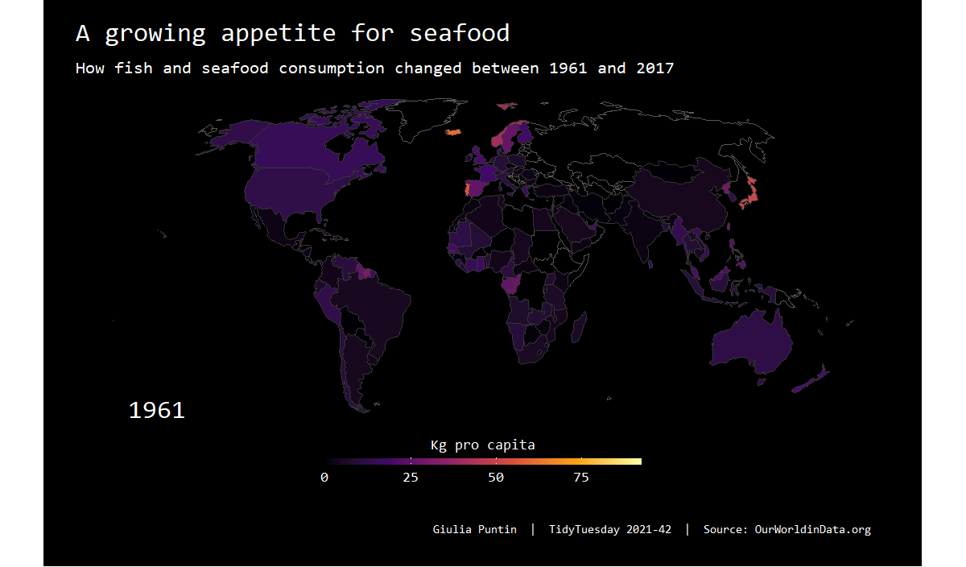
Beautiful plots with ggplot <3
Publication quality (BBC, Economist …)
Also just super beautiful:
Cedric Scherer website LINK
R graph gallery …

Slide 34

String manipulation stringr::str_*()
Work with character strings (text)
Uses regex (regular expressions): ways to describe patterns in text strings, to do things with them (
[same/similar rules as `grep` or `sed’ in Unix and bash]
Longer code than unix/bash but more human readable … (for me)
Example (we’ll see more later):
string <- "This is a string“
Here put an example of strings that carry a lot of diff info (e.g. Amu_A_1 … or something with genes …
Notes:
14.7 stringi
stringr is built on top of the stringi package. stringr is useful when you’re learning because it exposes a minimal set of functions, which have been carefully picked to handle the most common string manipulation functions. stringi, on the other hand, is designed to be comprehensive. It contains almost every function you might ever need: stringi has 256 functions to stringr’s 49.
If you find yourself struggling to do something in stringr, it’s worth taking a look at stringi. The packages work very similarly, so you should be able to translate your stringr knowledge in a natural way. The main difference is the prefix: str_ vs. stri_.

Slide 35
Practical part: R and Tidyverse in action!
All material (prez + script + data) downloadable from GitHub LINK
Quick intro to the dummy data set (made up by me with features to exemplify the above functions)

Slide 36
Overview of the data set
The R script is based on dummy data (modified from open data set for didactic purposes by me)
Add images of package with penguins
Original data: palmerpenguins::penguins_raw
For more info: ?penguins_raw
Describe structure:
Measurements of penguin stuff for three species in different locations. Picked coz: numeric data, character data and big enough that it would be annoying to do in Excel => good for showing my favorite Tidyverse functions

Slide 37
Workshop material
All material available to download from GitHub: presentation, data and R script(s)*
ADD SCREENSHOT
* Also R script that I used to modify penguins_raw for this demo (so even more Tidyverse stuff)

Slide 38
… and waaaay more!
This is just a short demonstration of what can be done (and how easily) in R Tidyverse, BUT there’s so much more out there!
Recommend:
Today: ask me/us about specific tasks/operations that you’d like to learn to execute in R
Any time: Check out the package cheat sheets (I used them a lot!) LINK HERE

Slide 39
Kidding, one last thing …
Explore the structure of the data (data type, replication, patterns …)
Check for mistakes and/or missing entries (always present in real world data)
Make the needed corrections in R
Re-shape the data (tables) to our needs - Prepare for stats (e.g. ANOVA)
Make some ggplots (exploratory & explanatory data viz!)

